Slide 1
FLIGHTS DATABASE

Slide 2
FLIGHTS(no: integer, fromPlace: string, toPlace: string, distance: integer, Departs: date, arrives: date, price: real)
AIRCRAFT(aid: integer, aname: string, cruisingrange: integer)
CERTIFIED(eid: integer, aid: integer)
EMPLOYEES(eid: integer, ename: string, salary: integer)

Slide 3
SCHEMA DIAGRAM
Flights
FNO
FP
TP
DISTANCE
ARRIVES
PRICE
Aircrafts
AID
ANAME
RANGE
Certified
EID
AID
Employees
EID
ENAME
SALARY

Slide 4
SCHEMA DIAGRAM
Flights
FNO
FP
TP
DISTANCE
ARRIVES
PRICE
Aircrafts
AID
ANAME
RANGE
Certified
EID
AID
Employees
EID
ENAME
SALARY

Slide 5
SCHEMA DIAGRAM
1
Flights
FNO
FP
TP
DISTANCE
ARRIVES
PRICE
Aircrafts
AID
ANAME
RANGE
2
4
Certified
EID
AID
3
Employees
EID
ENAME
SALARY

Slide 6
CREATE TABLE FLIGHTS
(no integer,
fromPlace varchar(20),
toPlace varchar(20),
distance integer,
departs date,
arrives date,
price real,
PRIMARY KEY(no));

Slide 7
CREATE TABLE AIRCRAFT
(aid integer,
aname varchar(15),
cruisingrange integer,
PRIMARY KEY(aid));

Slide 8
CREATE TABLE EMPLOYEES
(eid integer,
ename varchar(15),
salary integer,
PRIMARY KEY(eid));

Slide 9
CREATE TABLE CERTIFIED
(eid integer,
aid integer,
PRIMARY KEY(eid, aid),
FOREIGN KEY(eid) references EMPLOYEES(eid),
FOREIGN KEY(aid) references AIRCRAFT(aid));

Slide 10
SQL)SELECT * FROM FLIGHTS;
NO FROMPLACE TOPLACE DISTANCE DEPARTS ARRIVES PRICE
------ -------------------- -------------------- ---------- --------- --------- ------------------------------------------------------
255 bangalore frankfurt 200 01-AUG-11 01-AUG-11 5000
256 bangalore frankfurt 200 01-AUG-11 01-AUG-11 8000
257 bangalore delhi 200 01-AUG-11 01-AUG-11 5000
258 bangalore delhi 200 01-AUG-11 01-AUG-11 6000
259 bangalore mangalore 200 01-AUG-11 01-AUG-11 8000

Slide 11
SQL> SELECT * FROM AIRCRAFT;
AID ANAME GRANGE
--------------------------- -------------------------------------
685 boeing15 1000
686 boeing10 2000
687 skytrain 1000
688 avenger 100

Slide 12
SQL> SELECT * FROM EMPLOYEES;
EID ENAME SALARY
------------------------- ---------------------------
101 asha 90000
102 arun 85000
103 anand 3000
104 ramya 4000

Slide 13
SQL> SELECT * FROM CERTIFIED;
EID AID
---------------------------
101 685
101 686
101 687
101 688
102 685
103 686
103 687

Slide 14
1). Find the names of aircraft such that all pilots certified to operate them have salaries more than Rs.80,000.

Slide 15
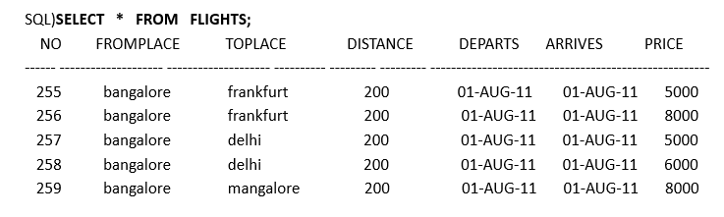
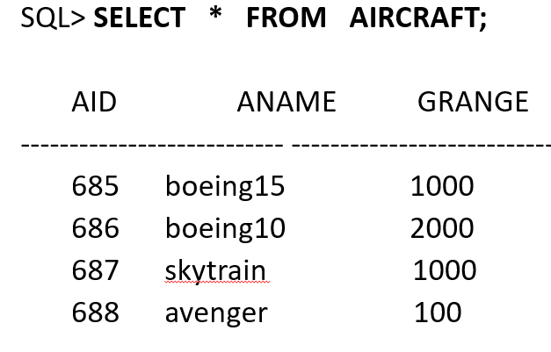

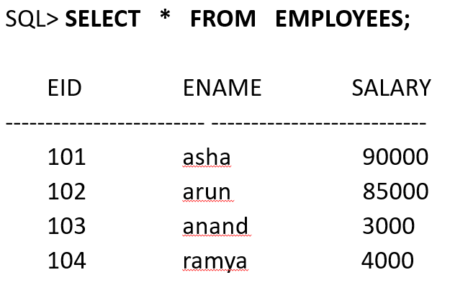
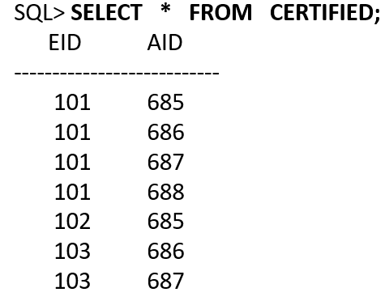

Slide 16
1). Find the names of aircraft such that all pilots certified to operate them have salaries more than Rs.80,000.
SELECT DISTINCT A.aname
FROM AIRCRAFT A, CERTIFIED C, EMPLOYEE E
WHERE A.aid = C.aid AND C.eid =E.eid AND E.salary >80000;

Slide 17
2). For each pilot who is certified for more than three aircrafts,find the eid and the maximum range of the aircraft for which she or he is certified.

Slide 19
2). For each pilot who is certified for more than three aircrafts,find the eid and the maximum range of the aircraft for which she or he is certified.
SELECT C.eid, MAX(a.cruisingrange)
FROM CERTIFIED C, AIRCRAFT A
WHERE C.aid = A.aid
GROUP BY C.eid
HAVING COUNT(*) > 3;

Slide 20
3). Find the names of pilots whose salary is less than the price of the cheapest route from Bengaluru to Frankfurt.

Slide 22
3). Find the names of pilots whose salary is less than the price of the cheapest route from Bengaluru to Frankfurt.
SELECT E.ename
FROM EMPLOYEES E
WHERE E.salary < 5000;

Slide 23
3). Find the names of pilots whose salary is less than the price of the cheapest route from Bengaluru to Frankfurt.
(SELECT min(price)
FROM FLIGHTS
WHERE fromPlace = 'bangalore' AND toPlace = 'frankfurt');

Slide 24
3). Find the names of pilots whose salary is less than the price of the cheapest route from Bengaluru to Frankfurt.
SELECT E.ename
FROM EMPLOYEES E
WHERE E.salary < (SELECT min(price)
FROM FLIGHTS
WHERE fromPlace = 'bangalore' AND toPlace = 'frankfurt');

Slide 25
4). Find the names of pilots certified for some Boeing aircraft.

Slide 27
4). Find the names of pilots certified for some Boeing aircraft.
SELECT DISTINCT E.ename
FROM AIRCRAFT A, CERTIFIED C, EMPLOYEES E
WHERE A.aid = C.aid AND C.eid = E.eid AND A.aname LIKE 'boeing%';

Slide 28
5)Find the aids of all aircraft that can be used on routes from Bengaluru to New Delhi.

Slide 30
5)Find the aids of all aircraft that can be used on routes from Bengaluru to New Delhi.
SELECT A.aid
FROM AIRCRAFT A
WHERE A.cruisingrange > (SELECT min(distance)
FROM FLIGHTS
WHERE fromPlace='bangalore' AND toPlace = 'delhi');

